Slide 1
Evolutionary Computing
Chapter 6
Popular Evolutionary Algorithm Variants
Part 1

Slide 2
Popular Evolutionary Algorithm Variants
Historical EA variants:
Genetic Algorithms (GA)
Evolution Strategies (ES)
Evolutionary Programming (EP)
Genetic Programming (GP)
More recent versions:
Differential Evolution (DE)
Particle Swarm Optimisation (PSO)
Learning Classifier Systems (LCS)
Estimation of Distribution Algorithms (EDA)

Slide 3
Genetic Algorithms: Quick Overview (1/2)
Developed: USA in the 1960’s
Early names: J. Holland, K. DeJong, D. Goldberg
Typically applied to:
discrete function optimization
benchmark
straightforward problems binary representation
Features:
not too fast
missing new variants (elitsm, sus)
often modelled by theorists

Slide 4
Genetic Algorithms: Quick Overview (2/2)
Holland’s original GA is now known as the simple genetic algorithm (SGA)
Other GAs use different:
Representations
Mutations
Crossovers
Selection mechanisms

Slide 5
SGA technical summary tableau
Representation | Bit-strings
Recombination | 1-Point crossover
Mutation | Bit flip
Parent selection | Fitness proportional – implemented by Roulette Wheel
Survivor selection | Generational

Slide 6
SGA reproduction cycle
Select parents for the mating pool
(size of mating pool = population size)
Shuffle the mating pool
Apply crossover for each consecutive pair with probability p_{c}, otherwise copy parents
Apply mutation for each offspring (bit-flip with probability p_{m} independently for each bit)
Replace the whole population with the resulting offspring

Slide 7
A GA example after Goldberg ’89
Simple problem: max x² over {0,1,…,31}
GA approach:
Representation: binary code, e.g., 01101 ↔ 13
Population size: 4
1-point xover, bitwise mutation
Roulette wheel selection
Random initialisation
We show one generational cycle done by hand

Slide 8
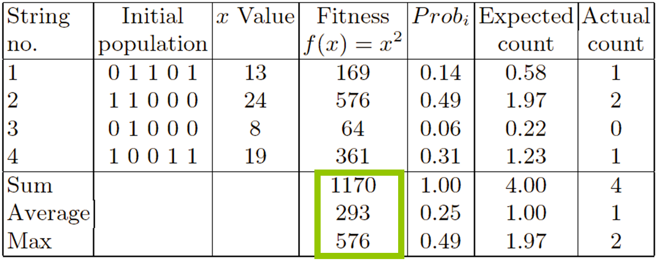
X² example: Selection

Slide 9
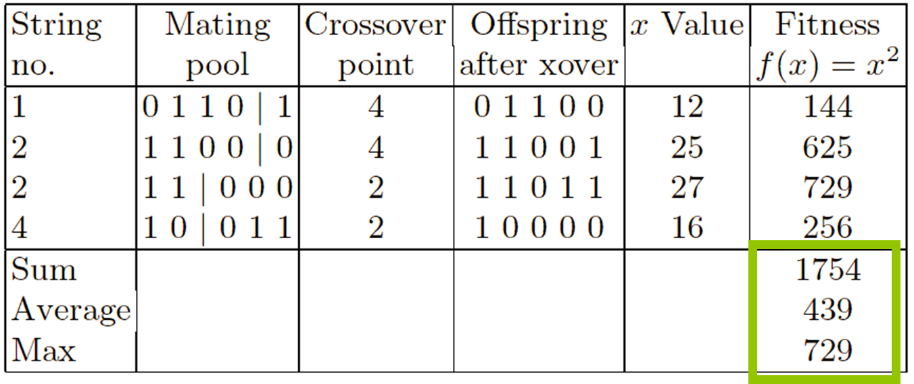
X² example: Crossover

Slide 10
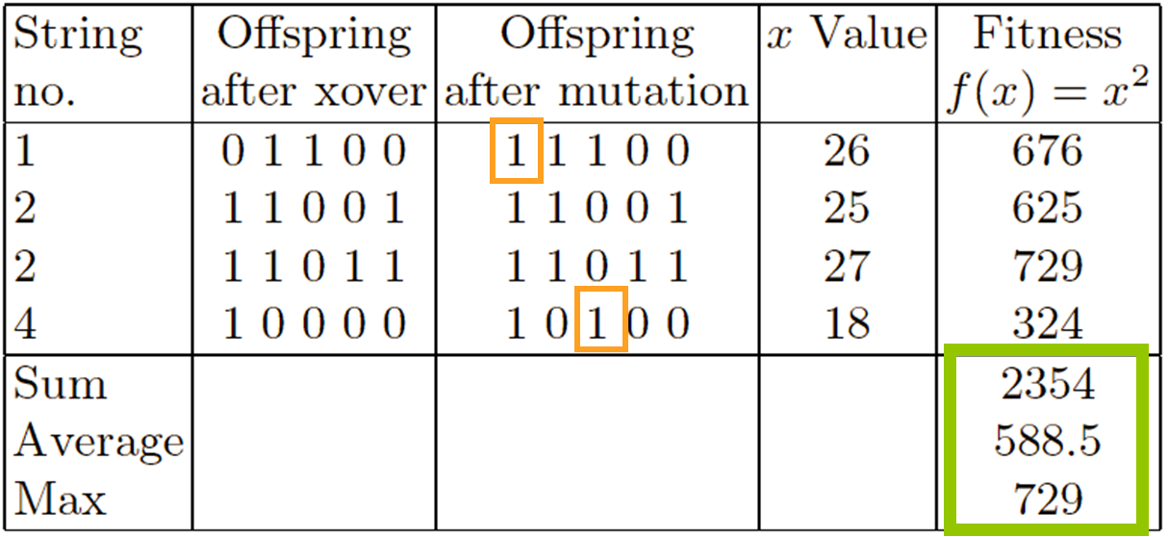
X² example: Mutation

Slide 11
The Simple GA
Has been subject of many (early) studies
still often used as benchmark for novel GAs
Shows many shortcomings, e.g.,
Representation is too restrictive
Mutation & crossover operators only applicable for bit-string & integer representations
Selection mechanism sensitive for converging populations with close fitness values
Generational population model (step 5 in SGA repr. cycle) can be improved with explicit survivor selection

Slide 12
Genetic Algorithms: Summary
Good for combinatorial optimisation, constraint satisfcation
Many different variants – lots of design choices
Large academic fanbase
The name GA is often (ab)used for a different EA

Slide 13
Evolution Strategies: Quick overview
Developed: Germany in the 1960’s
Early names: I. Rechenberg, H.-P. Schwefel
Typically applied to:
numerical optimisation
Attributed features:
fast
good optimizer for real-valued optimisation
relatively much theory
Special:
self-adaptation of (mutation) parameters standard

Slide 14
ES technical summary tableau
Representation | Real-valued vectors
Recombination | Discrete or intermediary
Mutation | Gaussian perturbation
Parent selection | Uniform random
Survivor selection | (μ,λ) or (μ+λ)

Slide 15
Evolution Strategies: Example (1+1) ES
Task: minimimise f : R^{n} → R
Algorithm: “two-membered ES” using
Vectors from R^{n} directly as chromosomes
Population size 1
Only mutation creating one child
Greedy selection
Example with historical interest
Is this thing really
evolutionary?

Slide 16
ES example mutation mechanism
z values drawn from normal distribution N(ξ,σ)
mean ξ is set to 0
variation σ is called mutation step size
σ is varied on the fly by the “1/5 success rule”:
This rule resets σ after every k iterations by
σ = σ / c if p_{s} > 1/5
σ = σ • c if p_{s} < 1/5
σ = σ if p_{s} = 1/5
where p_{s} is the % of successful mutations, 0.8 ≤ c ≤ 1

Slide 17
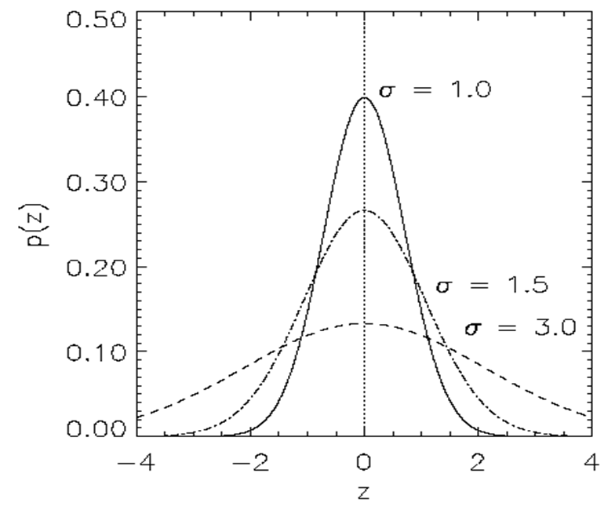
Evolution Strategies: Illustration of normal distribution

Slide 18
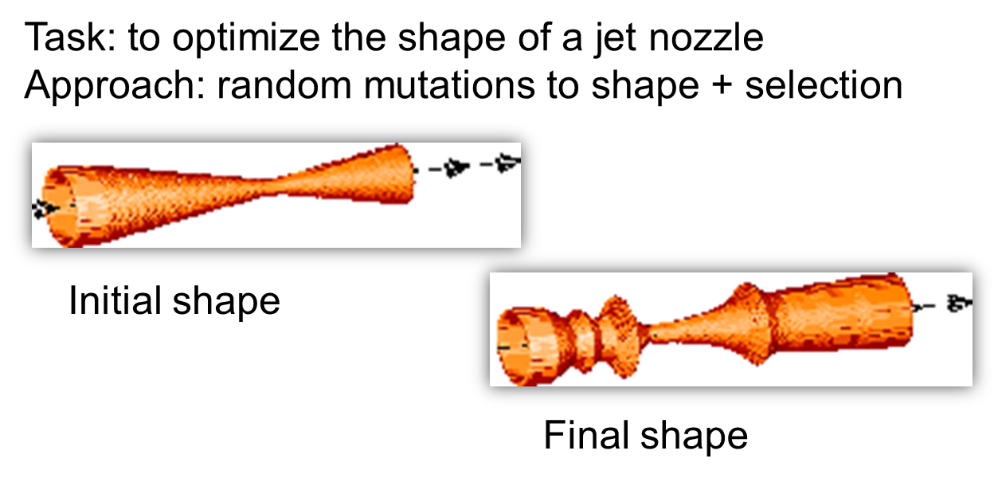
Another historical example: the jet nozzle experiment

Slide 19
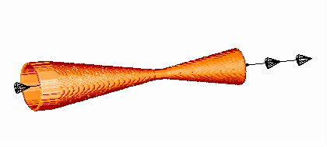
The famous jet nozzle experiment (movie)

Slide 20
Evolution Strategies: Representation
Chromosomes consist of three parts:
Object variables: x₁,…,x_{n}
Strategy parameters:
Mutation step sizes: σ₁,…,σ_{nσ}
Rotation angles: α₁,…, α_{nα}
Not every component is always present
Full size: ⟨ x₁,…,x_{n}, σ₁,…,σ_{n} ,α₁,…, α_{k} ⟩
where k = n(n-1)/2 (no. of i, j pairs)
Using the object variables directly, the
genotypes are the same as the phenotypes

Slide 21
Evolution Strategies: Recombination
Creates one child
Acts per variable / position by either
Averaging parental values, or
Selecting one of the parental values
From two or more parents by either:
Using two selected parents to make a child
Selecting two parents for each position independently
→ number of parents is random, but likely > 2

Slide 22
ES: Names of recombination operators
 | Two fixed parents | Two parents selected for each i
z_{i} = (x_{i} + y_{i})/2 | Local intermediary | Global intermediary
z_{i} is x_{i} or y_{i} chosen randomly | Local discrete | Global discrete

Slide 23
Evolution Strategies: Parent selection
Parents are selected by uniform random distribution whenever an operator needs one/some
Thus: ES parent selection is unbiased - every individual has the same probability to be selected

Slide 24
ES: Self-adaptation illustrated (1/2)
Given a dynamically changing fitness landscape (location of the optimum is shifted every 200 generations)
Self-adaptive ES is able to
follow the optimum and
adjust the mutation step size after every shift !

Slide 25
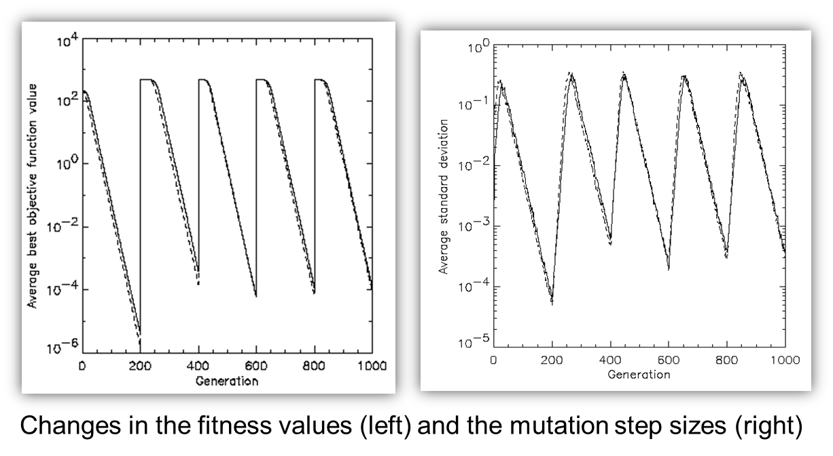
ES: Self-adaptation illustrated cont’d (2/2)

Slide 26
ES: Prerequisites for self-adaptation
μ > 1 to carry different strategies
λ > μ to generate offspring surplus
(μ,λ)-selection to get rid of misadapted σ‘s
Mixing strategy parameters by (intermediary) recombination on them

Slide 27
Evolution Strategies: Selection Pressure
Takeover time τ* is a measure to quantify the selection pressure
The number of generations it takes until the application of selection completely fills the population with copies of the best individual
Goldberg and Deb showed:
For proportional selection in a genetic algorithm the takeover time is λln(λ)

Slide 28
Example: The cherry brandy experiment
Task: to create a colour mix yielding a target colour (that of a well known cherry brandy)
Ingredients: water + red, yellow, blue dye
Representation: ⟨ w, r, y ,b ⟩ no self-adaptation!
Values scaled to give a predefined total volume (30 ml)
Mutation: lo / med / hi σ values used with equal chance
Selection: (1,8) strategy

Slide 29
Example: The cherry brandy experiment
Fitness: students effectively making the mix and comparing it with target colour – thus: so-called subjective selection
Termination criterion: student satisfied with mixed colour
Solution is found mostly within 20 generations
Accuracy is very good
Note: this is an application without a quantifiable fitness value – also the case when breeding animals

Slide 30
Example: The Ackley function, Bäck et al 93
The Ackley function (here used with n =30):
Evolution strategy:
Representation:
-30 < x_{i} < 30
30 step sizes
(30,200) selection
Termination : after 200000 fitness evaluations
Results: average best solution is 7.48 • 10 ^{–8} (very good)

Slide 31
Evolution Strategies: Summary
Very good for numerical optimisation
Can work with
low computational budgets (low maximum of fitness evaluations) and
high dimensional problems (large number of variables)
Self-adaptation of (mutation) parameters is standard
Fewer parameters and design choices than in GAs
Many applications in business and industry
Hint: try the CMA-ES from Hansen (open source code), look out for recent variants

Slide 32
Evolutionary Programming: Quick overview
Developed: USA in the 1960’s
Early names: L. Fogel
Typically applied to:
traditional EP: prediction by finite state machines
contemporary EP: (numerical) optimization
Attributed features:
very open framework: any representation and mutation op’s OK
crossbred with ES (contemporary EP)
consequently: hard to say what “standard” EP is
Special:
no recombination
self-adaptation of parameters standard (contemporary EP)

Slide 33
EP: Technical summary tableau
Representation | Real-valued vectors
Recombination | None
Mutation | Gaussian perturbation
Parent selection | Deterministic (each parent one offspring)
Survivor selection | Probabilistic (μ+μ)

Slide 34
Historical EP perspective
EP aimed at achieving intelligence
Intelligence was viewed as adaptive behaviour
Prediction of the environment was considered a prerequisite to adaptive behaviour
Thus: capability to predict is key to intelligence

Slide 35
EP: Prediction by finite state machines
Finite state machine (FSM):
States S
Inputs I
Outputs O
Transition function δ : S x I → S x O
Transforms input stream into output stream
Can be used for predictions, e.g. to predict next input symbol in a sequence

Slide 36
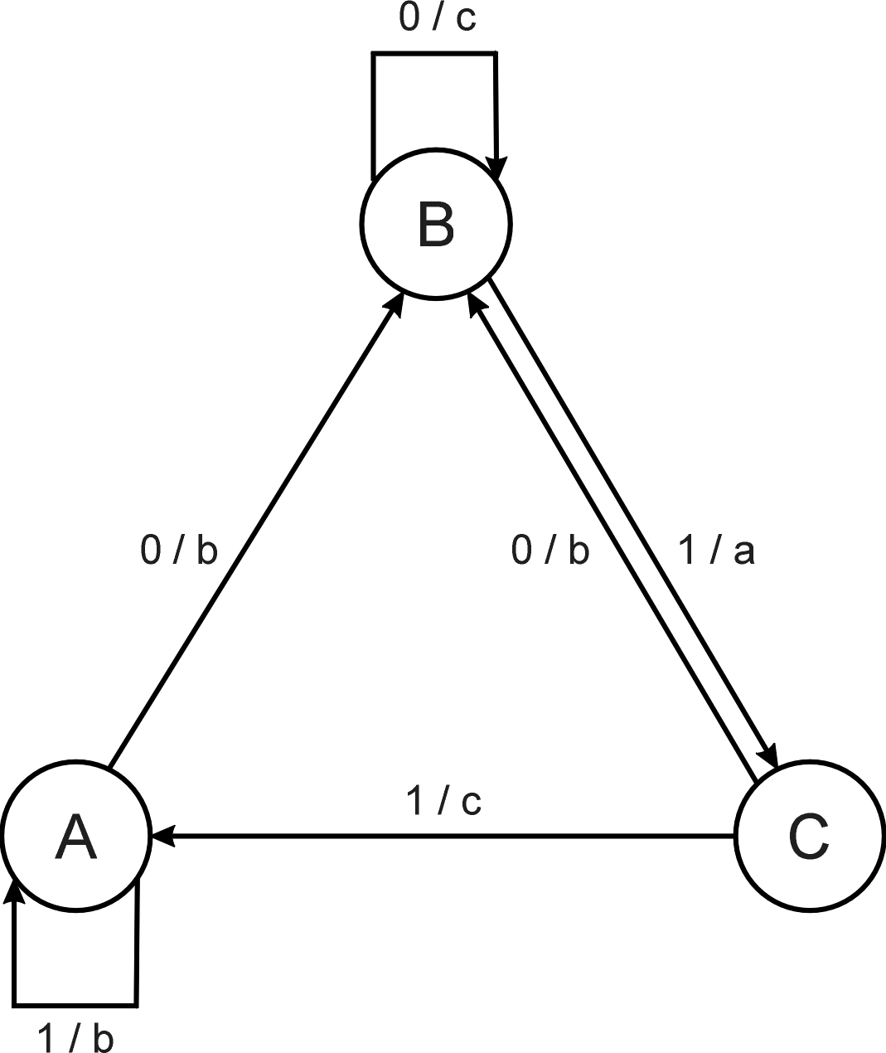
EP: FSM example
Consider the FSM with:
S = {A, B, C}
I = {0, 1}
O = {a, b, c}
δ given by a diagram

Slide 37
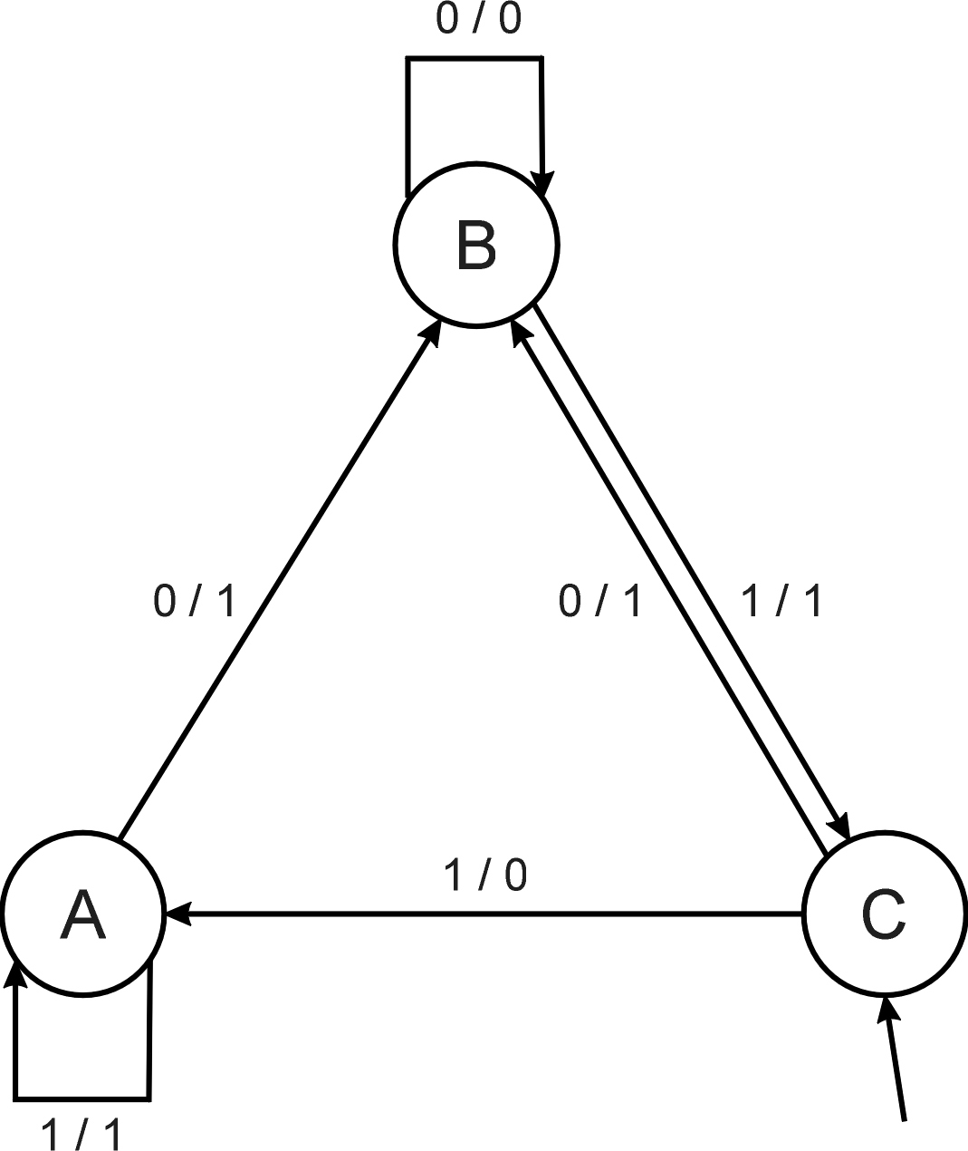
EP: FSM as predictor
Consider the following FSM
Task: predict next input
Quality: % of in_{(i+1)} = out_{i}
Given initial state C
Input sequence 011101
Leads to output 110111
Quality: 3 out of 5

Slide 38
EP: Evolving FSMs to predict primes (1/2)
P(n) = 1 if n is prime, 0 otherwise
I = N = {1,2,3,…, n, …}
O = {0,1}
Correct prediction: out_{i}= P(in(i+1))
Fitness function:
1 point for correct prediction of next input
0 point for incorrect prediction
Penalty for “too many” states

Slide 39
EP: Evolving FSMs to predict primes (1/2)
Parent selection: each FSM is selected to be mutated once
Mutation operators (one chosen randomly):
Change an output symbol
Change a state transition (i.e. redirect edge)
Add a state
Delete a state
Change the initial state
Survivor selection: (μ+μ)
Results: overfitting, after 202 inputs best FSM had one state and both outputs were 0, i.e., it always predicted “not prime”
Main point: not perfect accuracy but proof that simulated evolutionary process can create good solutions for intelligent task

Slide 40
Modern Evolutionary Programming
No predefined representation in general
Thus: no predefined mutation (must match representation)
Often applies self-adaptation of mutation parameters

Slide 41
Evolutionary Programming: Representation
For continuous parameter optimisation
Chromosomes consist of two parts:
Object variables: x₁,…,x_{n}
Mutation step sizes: σ₁,…,σ_{n}
Full size: ⟨ x₁,…,x_{n}, σ₁,…,σ_{n} ⟩

Slide 42
Evolutionary Programming: Mutation
Chromosomes: ⟨ x₁,…,x_{n}, σ₁,…,σ_{n} ⟩
σ_{i}’ = σ_{i} • (1 + α • N(0,1))
x_{i}’ = x_{i} + σ_{i}’ • N_{i}(0,1)
α ≈ 0.2
boundary rule: σ’ < ε₀ ⇒ σ’ = ε₀
Other variants proposed & tried:
Using variance instead of standard deviation
Mutate σ-last – BAD IDEA
Other distributions, e.g, Cauchy instead of Gaussian
Note the difference with the ES formula
σ’ = σ • exp(τ • N(0,1))

Slide 43
Evolutionary Programming: Recombination
None
Rationale: one point in the search space stands for a species, not for an individual and there can be no crossover between species
Much historical debate “mutation vs. crossover”

Slide 44
EP: Parent selection
Each individual creates one child by mutation
Thus:
Deterministic
Not biased by fitness

Slide 45
EP: Evolving checkers players (Fogel’02)
Overall strategy: go to the position with the highest expected value
Neural nets for evaluating future values of moves are evolved
NNs have fixed structure with 5046 weights, these are evolved + one weight for “kings”
Representation:
vector of 5046 real numbers for object variables (weights)
vector of 5046 real numbers for σ‘s
Thus, more than 10K variables to optimize
Mutation:
Gaussian, lognormal scheme with σ-first
Plus special mechanism for the kings’ weight
Population size 15

Slide 46
EP: Evolving checkers players (Fogel’02)
Tournament size q = 5
Programs (with NN inside) play against other programs, no human trainer or hard-wired intelligence – note the special character of the fitness function: no explicit formula
After 840 generation (6 months!) best strategy was tested against humans via Internet
Program earned “expert class” ranking outperforming 99.61% of all rated players

Slide 47
Evolutionary Programming: Summary
Less clear identity than GA and ES
Modern versions are hard to distinguish from ES
Branch is becoming less active / visible than other members of the EA family

Slide 48
Genetic Programming: Quick overview
Developed: USA in the 1990’s
Early names: J. Koza
Typically applied to:
machine learning tasks (prediction, classification…)
Attributed features:
competes with neural nets and other ML algorithms
needs huge populations (thousands)
slow
Special:
non-linear chromosomes: trees, graphs
mutation possible but not necessary

Slide 49
GP: Technical summary tableau
Representation | Tree structures
Recombination | Exchange of subtrees
Mutation | Random change in trees
Parent selection | Fitness proportional
Survivor selection | Generational replacement

Slide 50
GP example: credit scoring (1/3)
Bank wants to distinguish good from bad loan applicants
Model needed that matches historical data
ID | No of children | Salary | Marital status | OK?
ID-1 | 2 | 45000 | Married | 0
ID-2 | 0 | 30000 | Single | 1
ID-3 | 1 | 40000 | Divorced | 1
…

Slide 51
GP example: credit scoring (2/3)
A possible model:
IF (NOC = 2) AND (S > 80000) THEN good ELSE bad
In general:
IF formula THEN good ELSE bad
Only unknown is the right formula, hence
Our search space (phenotypes) is the set of formulas
Natural fitness of a formula: percentage of well classified cases of the model it stands for

Slide 52
GP example: credit scoring (3/3)
IF (NOC = 2) AND (S > 80000) THEN good ELSE bad
can be represented by the following tree
AND
=
>
NOC
2
S
80000

Slide 53
GP: Offspring creation scheme
Compare
GA scheme using crossover AND mutation sequentially (be it probabilistically)
GP scheme using crossover OR mutation (chosen probabilistically)

Slide 54
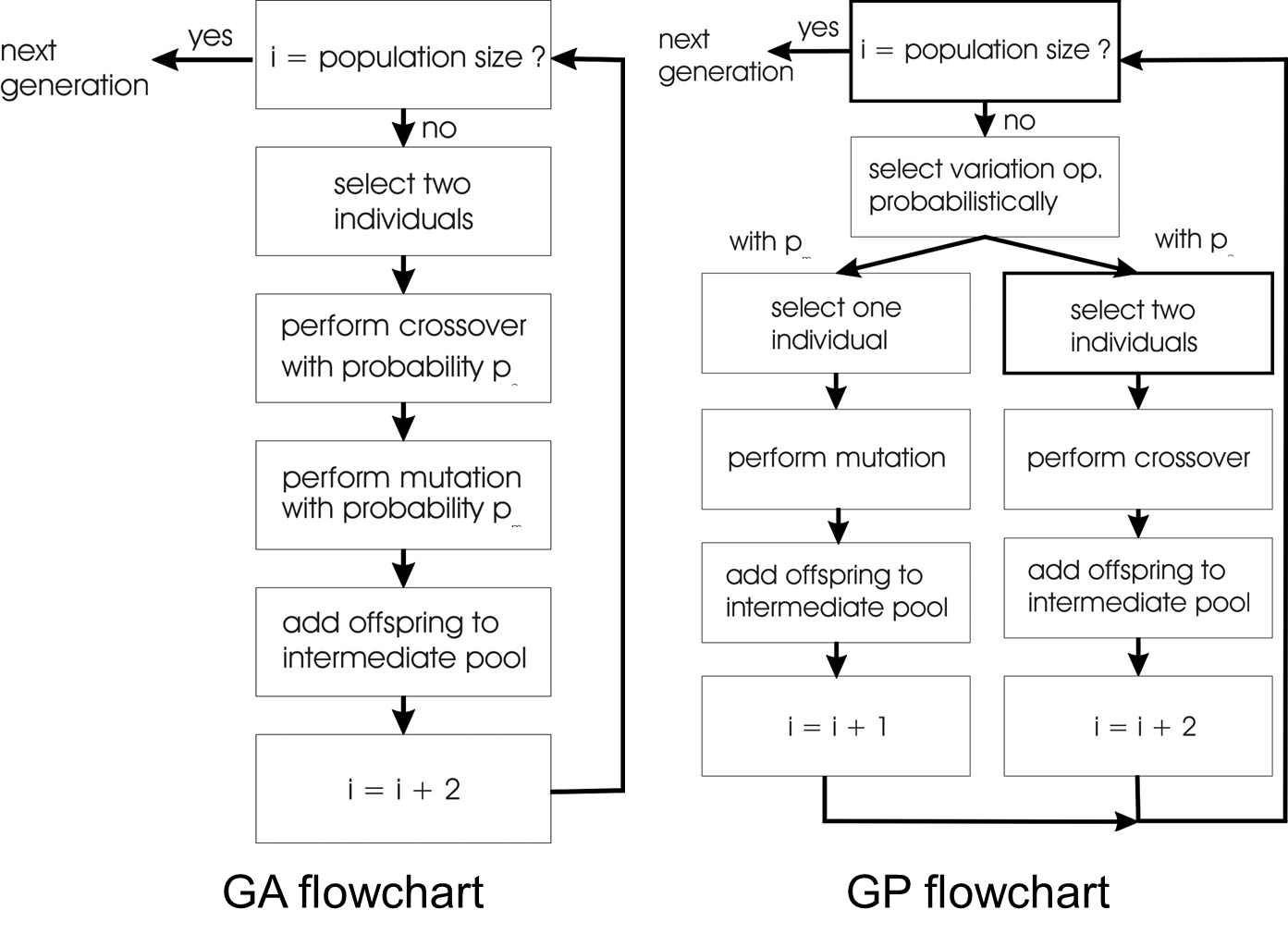
GA vs GP

Slide 55
Genetic Programming: Selection
Parent selection typically fitness proportionate
Over-selection in very large populations
rank population by fitness and divide it into two groups:
group 1: best x% of population, group 2 other (100-x)%
80% of selection operations chooses from group 1, 20% from group 2
for pop. size = 1000, 2000, 4000, 8000 x = 32%, 16%, 8%, 4% is recommended
motivation: to increase efficiency, %’s come from rule of thumb
Survivor selection:
Typical: generational scheme (thus none)
Recently steady-state is becoming popular for its elitism

Slide 56
Genetic Programming: Initialisation
Maximum initial depth of trees D_{max} is set
Full method (each branch has depth = D_{max}):
nodes at depth d < D_{max} randomly chosen from function set F
nodes at depth d = D_{max} randomly chosen from terminal set T
Grow method (each branch has depth ≤ D_{max}):
nodes at depth d < D_{max} randomly chosen from F ∪ T
nodes at depth d = D_{max} randomly chosen from T
Common GP initialisation: ramped half-and-half, where grow & full method each deliver half of initial population

Slide 57
Genetic Programming: Bloat
Bloat = “survival of the fattest”, i.e., the tree sizes in the population are increasing over time
Ongoing research and debate about the reasons
Needs countermeasures, e.g.
Prohibiting variation operators that would deliver “too big” children
Parsimony pressure: penalty for being oversized

Slide 58
GP: Example symbolic regression
Given some points in R², (x₁, y₁), … , (x_{n}, y_{n})
Find function f(x) s.t. ∀i = 1, …, n : f(x_{i}) = y_{i}
Possible GP solution:
Representation by F = {+, -, /, sin, cos}, T = R ∪ {x}
Fitness is the error
All operators standard
pop.size = 1000, ramped half-half initialisation
Termination: n “hits” or 50000 fitness evaluations reached (where “hit” is if | f(x_{i}) – y_{i} | < 0.0001)

Slide 59
Genetic Programming: Summary
Evolutionary approach to modelling and machine learning
Works for learning behavioural strategies / policies as well, e.g. for game playing strategies, robot controllers, agents
Results (trees) are readable – unlike neural networks – but the big size can make it impractical
Can require large populations and many generations, hence needs much time and/or powerful computing hardware
Has well documented impressive achievements, see e.g.,
the paper “Human-competitive results produced by genetic programming” on Canvas
the following video based on the paper Schmidt and Lipson, Distilling Free-Form Natural Laws from Experimental Data, Science, 324 , p81-85

Slide 60
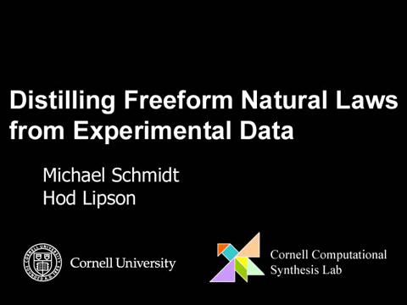
Schmidt and Lipson, Distilling Free-Form Natural Laws from Experimental Data, Science, 324 , p81-85 (3:20”)

